Slide 1


Huazhong University of Science and Technology
The Department of Electronics and Information Engineering
Electronic Circuit Analysis and Design
Dr. Tianping Deng
Email: dengtp@hust.edu.cn

Slide 2
Contents
PART 1 SEMICONDUCTOR DEVICES AND BASIC APPLICATIONS
Chapter 1 Semiconductor Materials and Diodes
Chapter 2 Diode Circuits
Chapter 3 The Field-Effect Transistor
Chapter 4 Basic FET Amplifiers
Chapter 5 The Bipolar Junction Transistor
Chapter 6 Basic BJT Amplifiers
Chapter 7 Frequency Response
Chapter 8 Output Stages and Power Amplifiers
PART 2 ANALOG ELECTRONICS
Chapter 9 Ideal Operational Amplifiers and Op-Amp Circuits
Chapter 10 Integrated Circuit Biasing and Active Loads
Chapter 11 Differential and Multistage Amplifiers
Chapter 12 Feedback and Stability
Chapter 13 Operational Amplifier Circuits
Chapter 14 Nonideal Effects in Operational Amplifier Circuits
Chapter 15 Applications and Design of Integrated Circuits
Chapter 7 Frequency Response

Slide 3
Ch7 Frequency Response
7.1 Amplifier Frequency Response
7.2 System Transfer Functions
7.3 Frequency Response：Transistor Amplifier with Circuit Capacitors
(P488-506)
7.4 Frequency Response：Bipolar Transistor
7.5 Frequency Response：FET
7.6 High-Frequency Response of Transistor Circuits

Slide 4

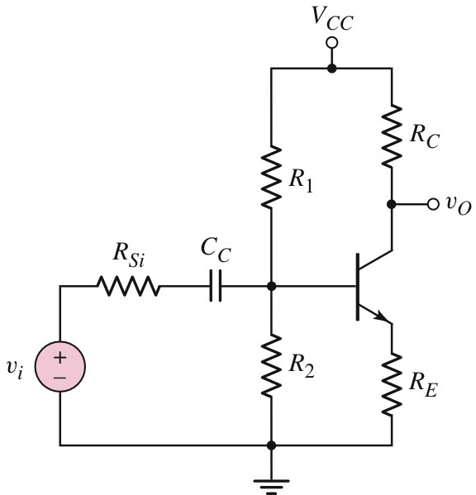

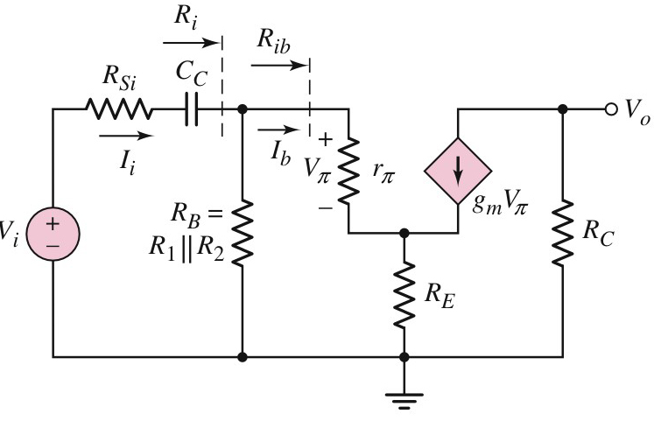



7.3 Frequency Response：Transistor Amplifier with Circuit Capacitors
7.3.1 Coupling Capacitor Effects（P488)
Not short
How to calculate open-circuit time constant ?

Slide 5
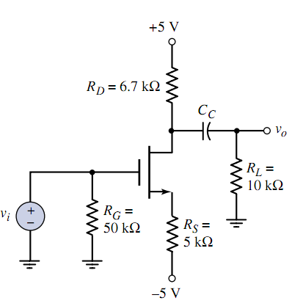
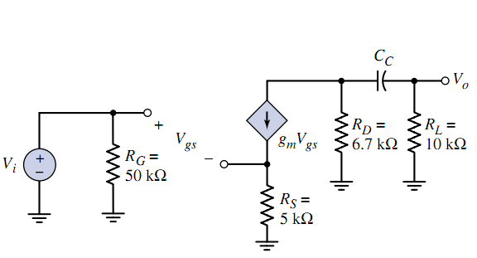



7.3 Frequency Response：Transistor Amplifier with Circuit Capacitors
7.3.1 Coupling Capacitor Effects（P491)
How to calculate open-circuit time constant ?

Slide 6
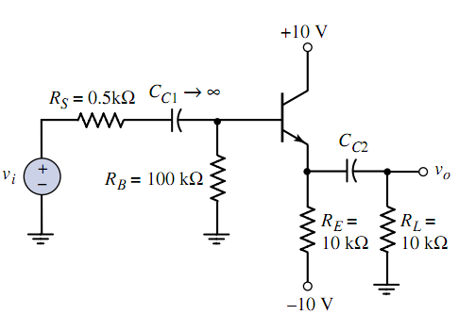

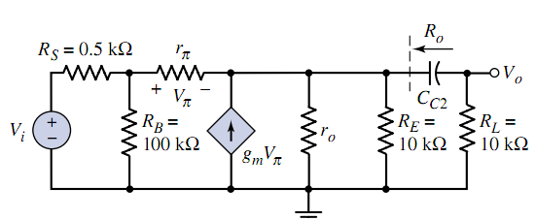


7.3 Frequency Response：Transistor Amplifier with Circuit Capacitors
7.3.1 Coupling Capacitor Effects（P493)
Mapping
How to calculate open-circuit time constant ?

Slide 7

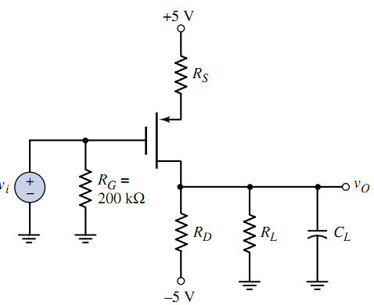
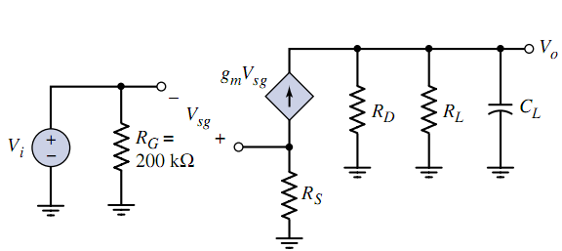
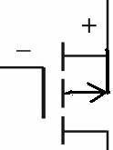

7.3 Frequency Response：Transistor Amplifier with Circuit Capacitors
7.3.2 Load Capacitor Effects（P495)
P-channel E-mode
How to calculate short-circuit time constant ?

Slide 8
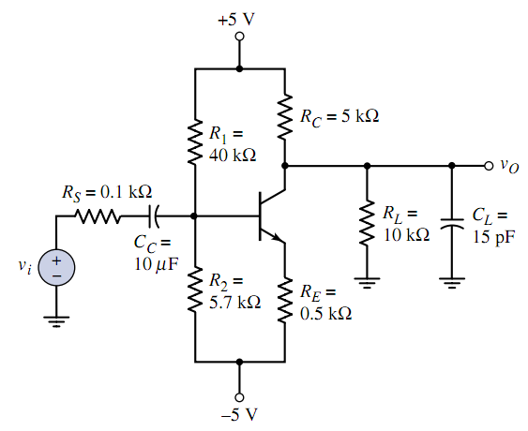



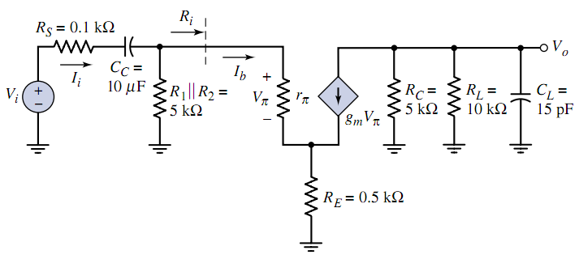



7.3 Frequency Response：Transistor Amplifier with Circuit Capacitors

Slide 9
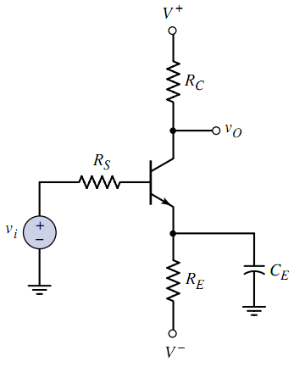


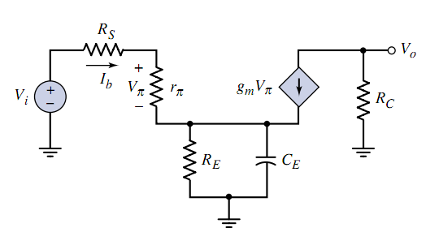



7.3 Frequency Response：Transistor Amplifier with Circuit Capacitors
（P500)

Slide 10

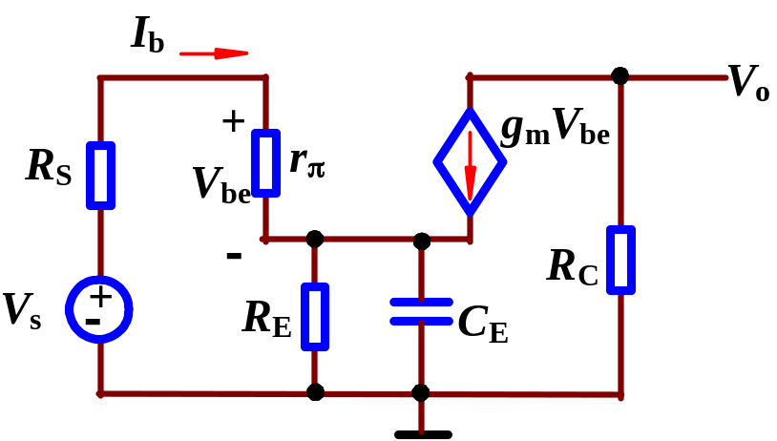
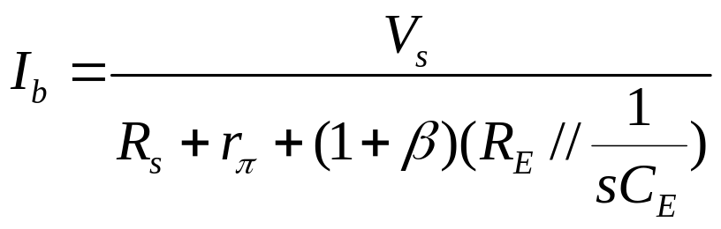
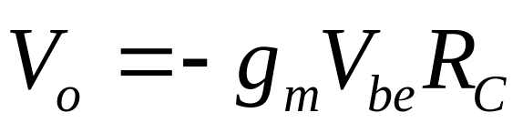
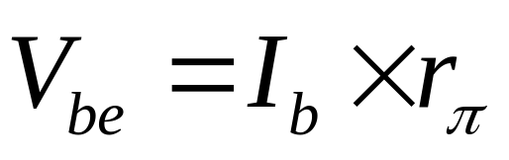
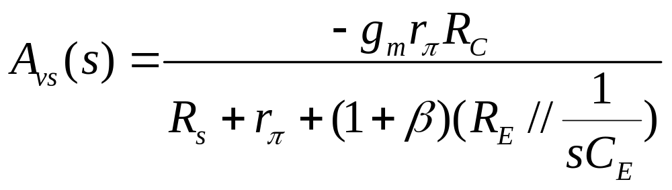
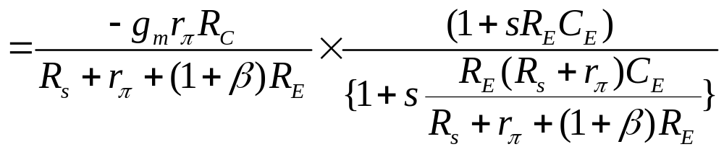
(b) Voltage gain

Slide 11
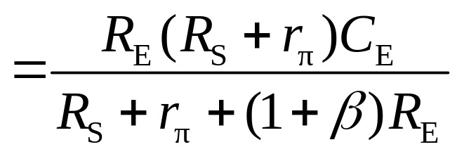
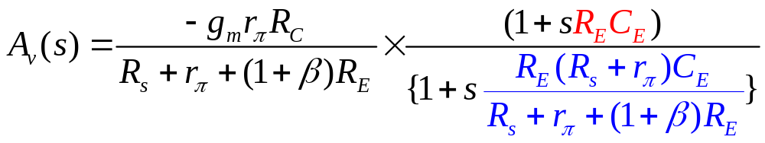
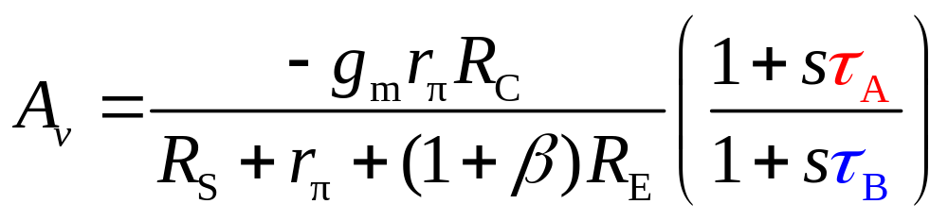
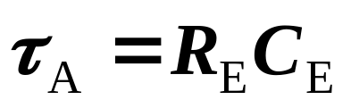
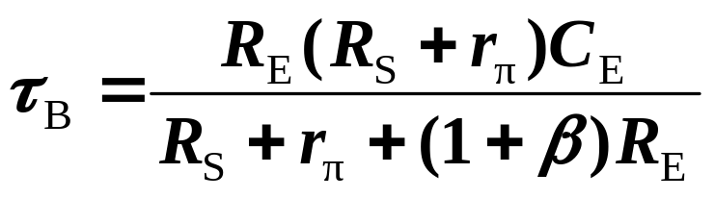

Slide 12
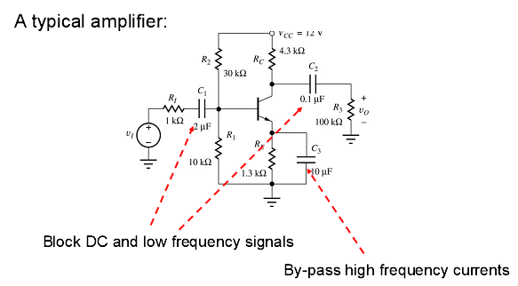
Coupling capacitors
bypass capacitor

Slide 13

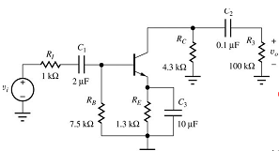
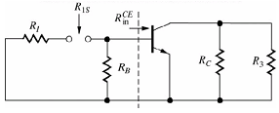



Slide 14
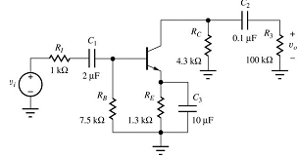

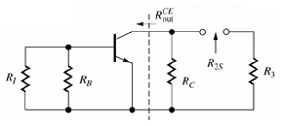




Slide 15
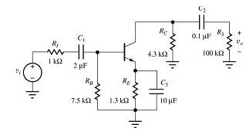
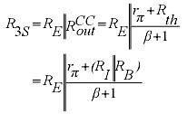



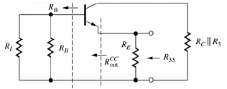


Slide 16
Problem-Solving Technique:
Bode Plot of Gain Magnitude
Determine whether capacitor is producing a low-pass or high-pass circuit.
  Sketch general shape of Bode plot
Corner frequency is f = 1/(2πτ) where τ = R_{eq}C
  R_{eq} is resistance seen by capacitor
Maximum gain magnitude is midband gain.
  Coupling and bypass capacitors act as shorts
  Load capacitors act as opens

Slide 17
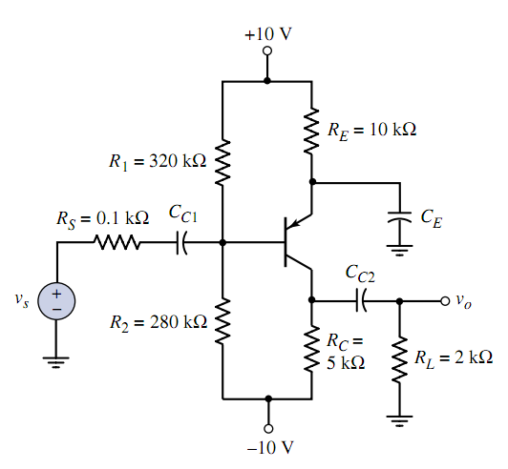
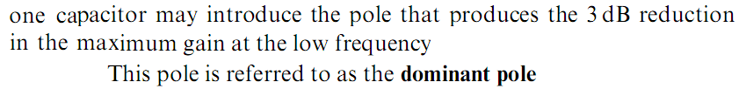
（P504)

Slide 18
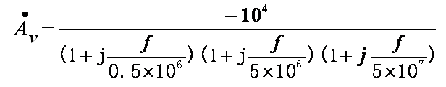

（P504)
Three poles
f_{p1}=0.5×10⁶Hz ， f_{p2}=5×10⁶Hz ， f_{p3}=5×10⁷Hz

Slide 19

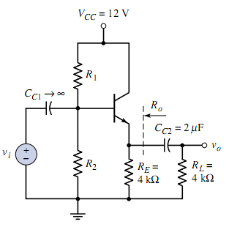
Homework P547 D7.17

Slide 20
Questions
and
Answers

